Slide 1
DIET AND HEALTH, ANY LINK?
Paper Presented
@
AGM
Of
NNPC CMC COOPERATIVE
LAGOS.
On
10th July, 2014
By
Dietitian Tunde Ajobo (RD) MNDA
University College Hospital, Ibadan.

Slide 2
Introduction
Human require six basic dietary components to support growth and maintain life and health. They are carbohydrates, proteins, fats and oil (Macro nutrients) vitamins, minerals (Micro-nutrients) and water.

Slide 3
Scientific evidence has only recently established the fact that some nutrients in our diet are agents that cause or cure certain diseases. Food - Natural or manufactured product, solid or liquid, that contains one or more of the nutrients that the human organism requires for the development and vital functions.

Slide 5
It was first demonstrated in studies with laboratory animals and later on humans that the lack of certain foods in the diet caused deficiency diseases, such as rickets, and that the inclusion of other foods cured patients with those diseases.

Slide 6
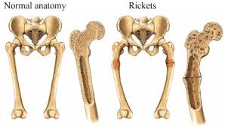

Slide 7
In recent years, nutritional investigation has concentrated on the effect diet has on the prevention and treatment of circulatory disease, diabetes, cancer and obesity, since these are currently the most frequent. Population and clinical studies have demonstrated, for example, that the abundant use of fruits, as well as vegetables, are rich in powerful antioxidants such as vitamins A, C and E, selenium and flavonoids.

Slide 8
They prevent premature aging, avoid cancer and enhance the immune system. They also contain hundreds of substances known as phytochemicals that carry out important preventive and healing functions.

Slide 9
The eating of whole grain cereals and oil bearing nuts reduces excess levels of cholesterol in the blood and risk of myocardial infraction. On the other hand, the consumption of a great deal of meat increases the risk of cardiovascular disease and some type of cancer.

Slide 10
Thus, we see that the choice, frequency and quality of the foods that we eat directly affect our health. Many follow a diet characterized by excessive calorie consumption and frequent nutritional imbalances.

Slide 12
It is estimated that there are 76million cases of food borne illness in the United State per year. Each year, food borne diseases cause more than 300,000 hospitalizations and an estimated 5,000 deaths.

Slide 13
Infacts, one of every 100 hospitalizations and one of every 500 deaths in the United States are thought to result from contaminated food. It is estimated that from one in three to one in four people will suffer a food-borne illness each year.

Slide 14
The actual number of illness may be much higher because food borne illness is underreported and often misdiagnosed. Many people with mild cases do not seek medical help. Why? Because symptoms are often nonspecific-nausea, vomiting and diarrhea-food poisoning can be mistaken for the flu or some other common ailment.

Slide 15
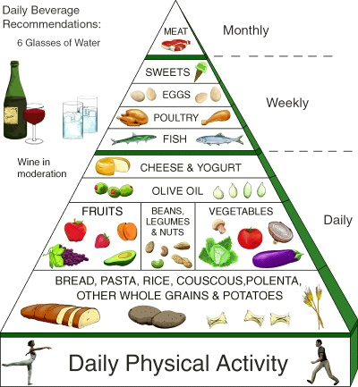
Looking back in history, around 460 BC, Hippocrates recognized the essential relationship between food and health. He urged others to study closely the daily dietary regimen he associate with good health.

Slide 16
Theophrases, who lived from 370-285 BC, wrote Enquiry Into Plants, the first great botanical treatise that identified plants as sources of food and medicine. Sailors are well aware of this since 1747, when the Scottish physician James Lind demonstrated that eating two oranges and a lemon daily prevented and cured scurvy.

Slide 17
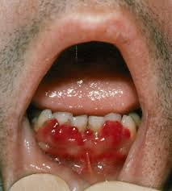

Slide 18
Pliny the Elder, the author of Natural History, lived from AD 22-79. He found wide spread adulterations in the food supply, describing bread as being full of “chalk” vegetable meals and even cattle fodder. He also found that pepper was often adulterated with juniper berries.

Slide 19
Food fortification began in the United State in 1924 with the introduction of iodized salt in Michigan. Studies showed that the incident of goiter a swelling of the thyroid gland cause by iodine deficiency. Iodized salt, virtually eliminating iodine deficiency as a serious health treat by the 1930s.

Slide 21
In the early 1900s, pellagra occurred to some extent in every state, and mortality statistics indicated that it was the most severe nutritional deficiency ever recorded in U.S. history. Pellagra – disease of 3 Ds. Dermatitis, diarrhea and dementia. In 1937, the disease was tied directly to a dietary deficiency in B vitamin niacin.

Slide 22
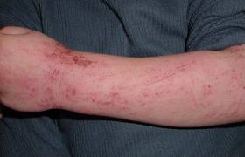
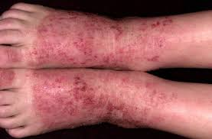

Slide 23
Moreover, an over abundance of sugar, over indulgence in processed foods and lack of control in portion size, contribute to Epidemics of dental caries, cardiovascular disease, diabetes and obesity.

Slide 24
Conclusively, foods can prevent and cure diseases but they can also cause them. Therefore, the best diet is not one that includes “ a little of everything” but one that avoids the harmful and makes moderate use of the beneficial. What needs work is individual commitment to healthier eating and an active lifestyle

Slide 25
Less sugar, more whole-grain cereals and breads, three to four fresh fruits a day, green vegetables and so on, coupled with exercise routines could make a remarkable difference in the overall health.

Slide 26
There is need to safe guide nutrient lost from farm to table and prevent food adulteration and chemicals that are injurious to human health. I will end with these two quotations:

Slide 27
“The doctor of the future will give no medicines, but will interest his patients in the care of the human body, in DIET and in the cause and prevention of Diseases”. Thomas Edison (1847-1931).

Slide 28
He who does not know food, how can he understand the diseases of man?
“May your food be your medicine and your medicine be your FOOD”. Hippocrates; Greek Physician 5th centuries” BC.

Slide 29
Thank You!
for listening!

